Slide 1
Chapter 3
Random Variables and Probability Distributions
Chapter 3
Random Variables and
Probability Distributions

Slide 2
Chapter 3.1
Concept of a Random Variable
Concept of a Random Variable
Random variable is a function that associates a real number with each element in the sample space.
In other words, random variable is a numerical description of the outcome of an experiment, where each outcome gets assigned a numerical value.
A capital letter, say X, is used to denotes a random variable and its corresponding small letter, x in this case, for one of its values.

Slide 3
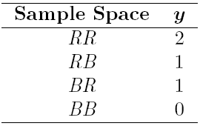
Chapter 3.1
Concept of a Random Variable
Concept of a Random Variable
The sample space giving a detailed description of each possible outcome when three electronic components are tested may be written as
One is concerned with the number of defectives that occurs. Thus each point in the sample space will be assigned a numerical value of 0, 1, 2, or 3.
Then, the random variable X assumes the value 2 for all elements in the subset
Two balls are drawn in succession without replacement from an urn containing 4 red balls and 3 black balls. The possible outcomes and the values y of the random variable Y, where Y is the number of red balls are

Slide 4
Chapter 3.1
Concept of a Random Variable
Sample Space and Random Variable
If a sample space contains a finite number of possibilities or an unending sequence with as many elements as there are whole numbers, it is called a discrete sample space.
If a sample space contains an infinite number of possibilities equal to the number of points on a line segment, it is called a continuous sample space.
A random variable is called a discrete random variable if its set of possible outcomes is countable.
A random variable is called a continuous random variable if it can take on values on a continuous scale.
If X is the random variable assigned to the waiting time, in minute, for a bus at a bus stop, then the random variable X may take on all values of waiting time x, x ≥ 0.
In this case, X is a continuous random variable.

Slide 5
Chapter 3.2
Discrete Probability Distributions
Discrete Probability Distributions
Frequently, it is convenient to represent all the probabilities of a random variable X by a formula.
Such a formula would necessarily be a function of the numerical values x, denoted by f(x), g(x), r(x), and so forth.
For example,
The set of ordered pairs (x, f(x)) is a probability function, probability mass function, or probability distribution of the discrete random variable X if, for each possible outcome x,

Slide 6

Chapter 3.2
Discrete Probability Distributions
Discrete Probability Distributions
In the experiment of tossing a fair coin twice, the random variable X represents how many times the head turns up. The possible value for x of X and their probability can be summarized as

Slide 7
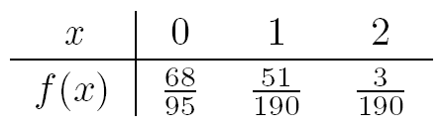
Chapter 3.2
Discrete Probability Distributions
Discrete Probability Distributions
A shipment of 20 similar laptop computers to a retail outlet contains 3 that are defective. If a school makes a random purchase of 2 of these computers, find the probability distribution for the number of defectives.
Let X be a random variable, whose value x are the possible numbers of defective computers purchased by the school.

Slide 8
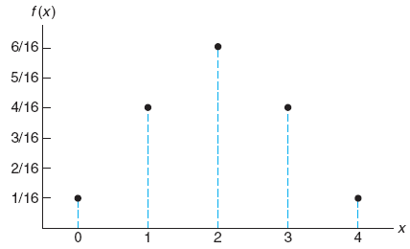
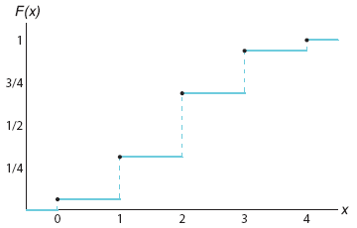
Chapter 3.2
Discrete Probability Distributions
Discrete Probability Distributions
There are many problems where we may wish to compute the probability that the observed value of a random variable X will be less than or equal to some real number x.
The cumulative distribution F(x) of a discrete random variable X with probability distribution f(x) is
Example of a probability distribution
Example of a cumulative distribution

Slide 9
Chapter 3.3
Continuous Probability Distributions
Continuous Probability Distributions
In case the sample space is continuous, there can be unlimited number of possible value for the samples.
Thus, it is more meaningful to deal with an interval rather than a point value of a random variable.
For example, it does not make sense to know the probability of selecting person at random who is exactly 164 cm tall. It will be more useful to talk about the probability of selecting a person who is at least 163 cm but not more than 165 cm.
We shall concern ourselves now with computing probabilities for various intervals of continuous random variables such as
P(a < X < b), P(W ≥ c), P(U ≤ d) and so forth.
Note that when X is continuous
Probability of a point value is zero

Slide 10
Chapter 3.3
Continuous Probability Distributions
Continuous Probability Distributions
In dealing with continuous variables, the notation commonly used is f(x) and it is usually called the probability density function, or the density function of X.
For most practical application, the density functions are continuous and differentiable.
Their graphs may take any forms, but since it will be used to represent probabilities, the density function must lie entirely above the x axis to represent positive probability.
f(x)
f(x)
f(x)
x
x
x

Slide 11
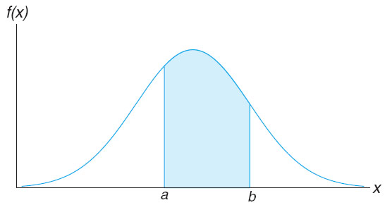
Chapter 3.3
Continuous Probability Distributions
Continuous Probability Distributions
A probability density function is constructed so that the area under its curve bounded by the x axis is equal to 1 when computed over the range of X for which f(x) is defined.
In the figure below, the probability that X assumes a value between a and b is equal to the shaded area under the density function between the ordinates at x = a and x = b.

Slide 12
Chapter 3.3
Continuous Probability Distributions
Continuous Probability Distributions
The function f(x) is a probability density function for the continuous random variable X, defined over the set of real numbers R if

Slide 13
Chapter 3.3
Continuous Probability Distributions
Continuous Probability Distributions
Suppose that the error in the reaction temperature, in °C, for a controlled laboratory experiment is a continuous random variable X having the probability density function
Verify whether
Find P(0 < X ≤ 1)

Slide 14
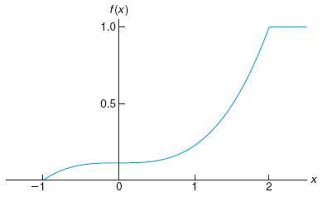
Chapter 3.3
Continuous Probability Distributions
Continuous Probability Distributions
The cumulative distribution F(x) of a continuous random variable X with density function f(x) is
For the density function in the last example, find F(x) and use it to evaluate P(0 < X ≤ 1).

